Slide 1
3,042
IPv4 Reachable Full Bitcoin Nodes
01
operators: 1

Slide 2
IP and ASN assumptions are wrong
45.40.98.0/24
173.46.87.0/24
RENT
/24
66.163.223.0/24
174.140.231.0/24
$120–150
89.106.27.0/24
184.174.95.0/24
/month
bitprojects
103.47.56.0/24
1 operator
203.11.72.0/24
BUY
/24
103.246.186.0/24
206.206.109.0/24
~$7K
123.100.246.0/24
216.107.135.0/24
Resellable asset
12 × /24 · 3 ASNs · No /16 in common
02
Experiment economics: speaker-supplied estimates. Twelve subnets supplied by the operator.
operators: 1

Slide 3
A single entity can hide in plain sight
45.40.0.0/16
66.163.0.0/16
89.106.0.0/16
103.47.0.0/16
103.246.0.0/16
123.100.0.0/16
45.40.98.0/24
66.163.223.0/24
89.106.27.0/24
103.47.56.0/24
103.246.186.0/24
123.100.246.0/24
173.46.0.0/16
174.140.0.0/16
184.174.0.0/16
203.11.0.0/16
206.206.0.0/16
216.107.0.0/16
173.46.87.0/24
174.140.231.0/24
184.174.95.0/24
203.11.72.0/24
206.206.109.0/24
216.107.135.0/24
12 × /24 · 0 shared /16 boundary
Proxy services = even more distributed
AS12029
AS29798
AS401199
3 ASNs used (5 available)
03
operators: 1

Slide 4
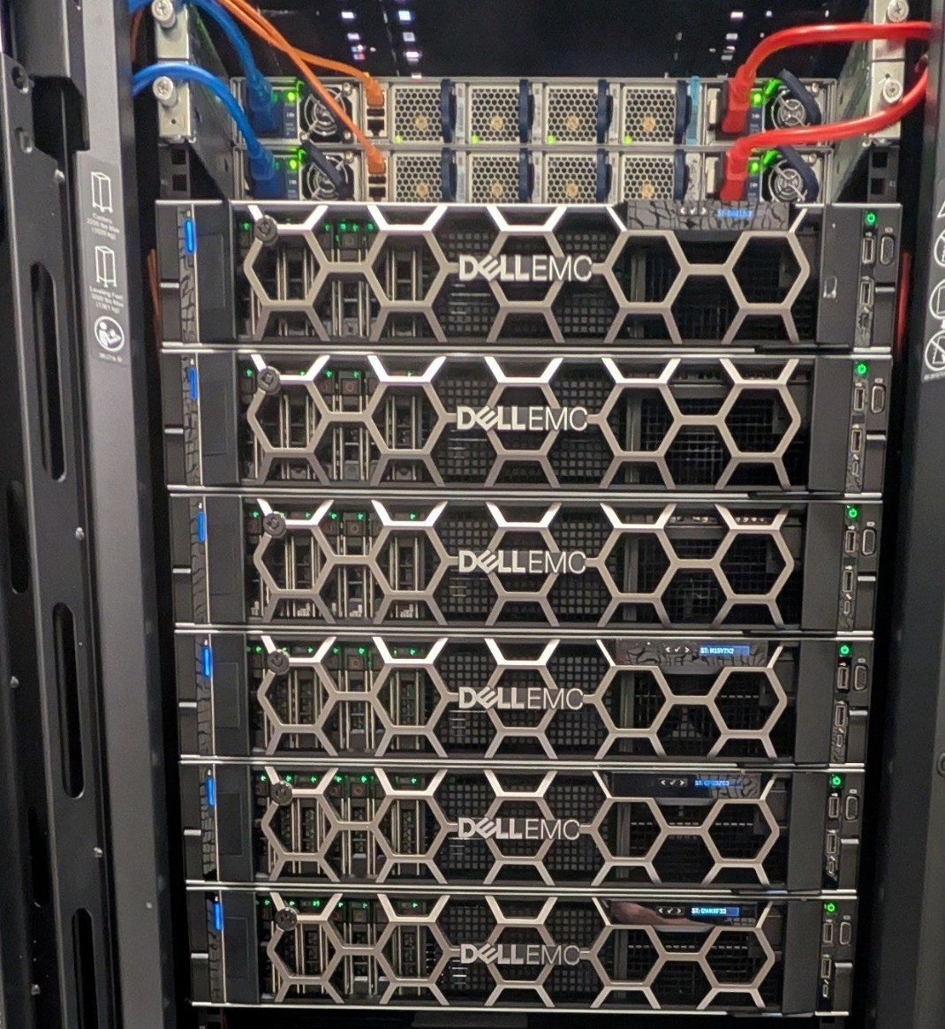
Cost assumptions
are wrong
$2–3K
/month
Operating cost
6× Dell R740
512GB each · refurbished
~$2,500 each · hardware purchase
04
Photo and cost estimates: Joe Antek
operators: 1

Slide 5
3,042 endpoints in half a rack
1 operator
AS12029
36
HAProxy
full node instances
/24
/24
/24
/24
inbound
AS29798
/24
/24
/24
Dante + HAProxy
outbound seeding
Proxmox · LXC
policy routing
ZFS dedup + linked clones
05
Architecture and counts: Joe Antek. Dots are endpoints; server symbols are full node instances.
operators: 1

Slide 6
The network found me
#bitcoin-core-dev · 04 Dec 2025
<darosior> jonatack: yes, he does seem quite confused about how
all of this work, but i must hand it to him that i expected us
to be more robust than that and his mainnet experiment
demonstrated it to me
<eugenesiegel> I think this guy could cause some damage if he
withheld blocks, even if only for 10 minutes...
<darosior> Definitely
JUN 2025
17 OCT 2025
21 OCT 2025
04 DEC 2025
19 MAR 2026
LATE MAR 2026
Investigation
User agent
+2,040 IPs
Core IRC
BIP 110 signal
Public attention
06
Bitcoin Core IRC, 4 Dec 2025; BNOC threads 40 and 45. Full supplied IRC messages in companion file.
operators: 1

Slide 7
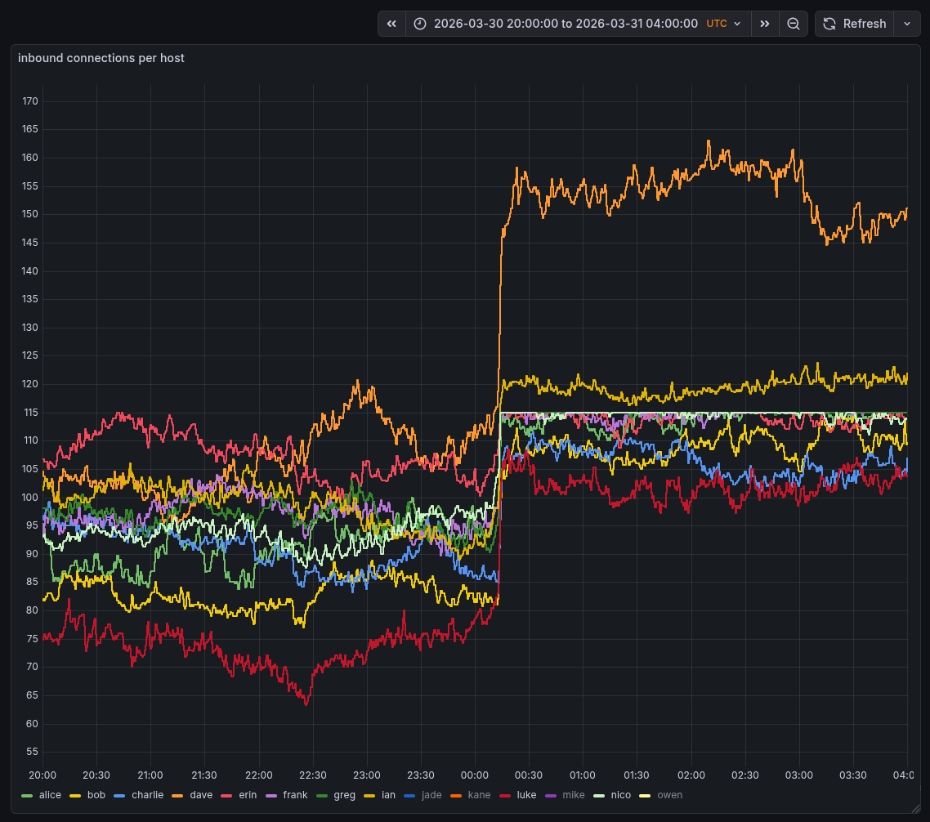
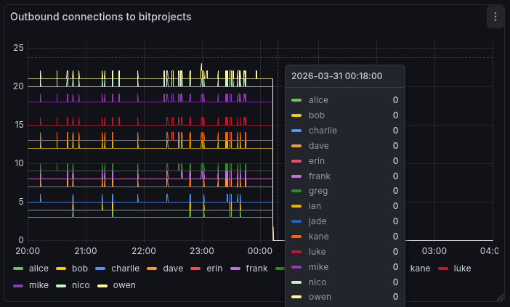
End of the experiment
March 31, 2026 · 00:12 UTC
80,526 → 0
Inbound on b10c’s monitors
00:12
inbound connections
00:12
07
Charts: b10c monitoring hosts, BNOC #108. Left: outbound to bitprojects. Right: inbound per host.
operators: 1

Slide 8

What to do
RUN NODES
CONNECT TO
HONEST NODES
USE A BEACON
Run nodes. Make them
listening on IPv4, Tor,
and I2P.
Always have a connection
to at least one honest node.
Some method of a beacon
that tests for connections to
the same node/entity
appearing as multiple
different IPs/endpoints
Increase outbound connections
from 12 to 48-64
Public reachability is
the attack surface —
and the defense.
(contentious — believed the
network can't handle this)
Also connect via Tor and I2P
for network diversity
Reach out if you
want my help.
bitprojects.io
08
operators: 1

Slide 9
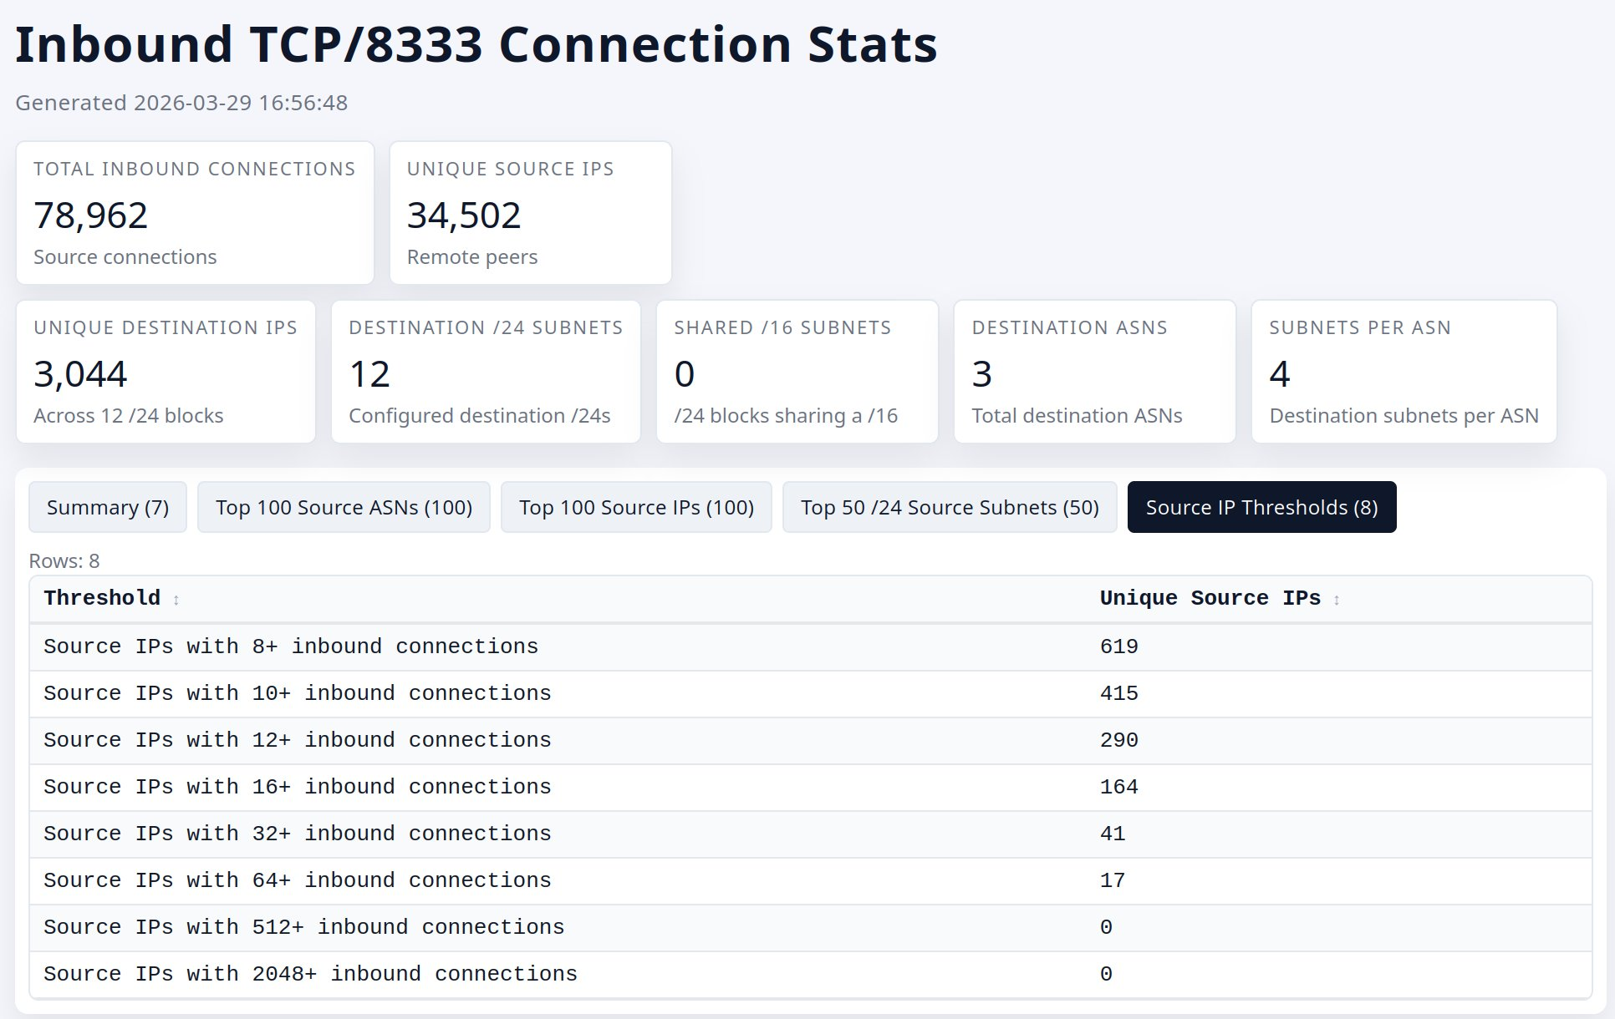
operators: 1

Slide 10
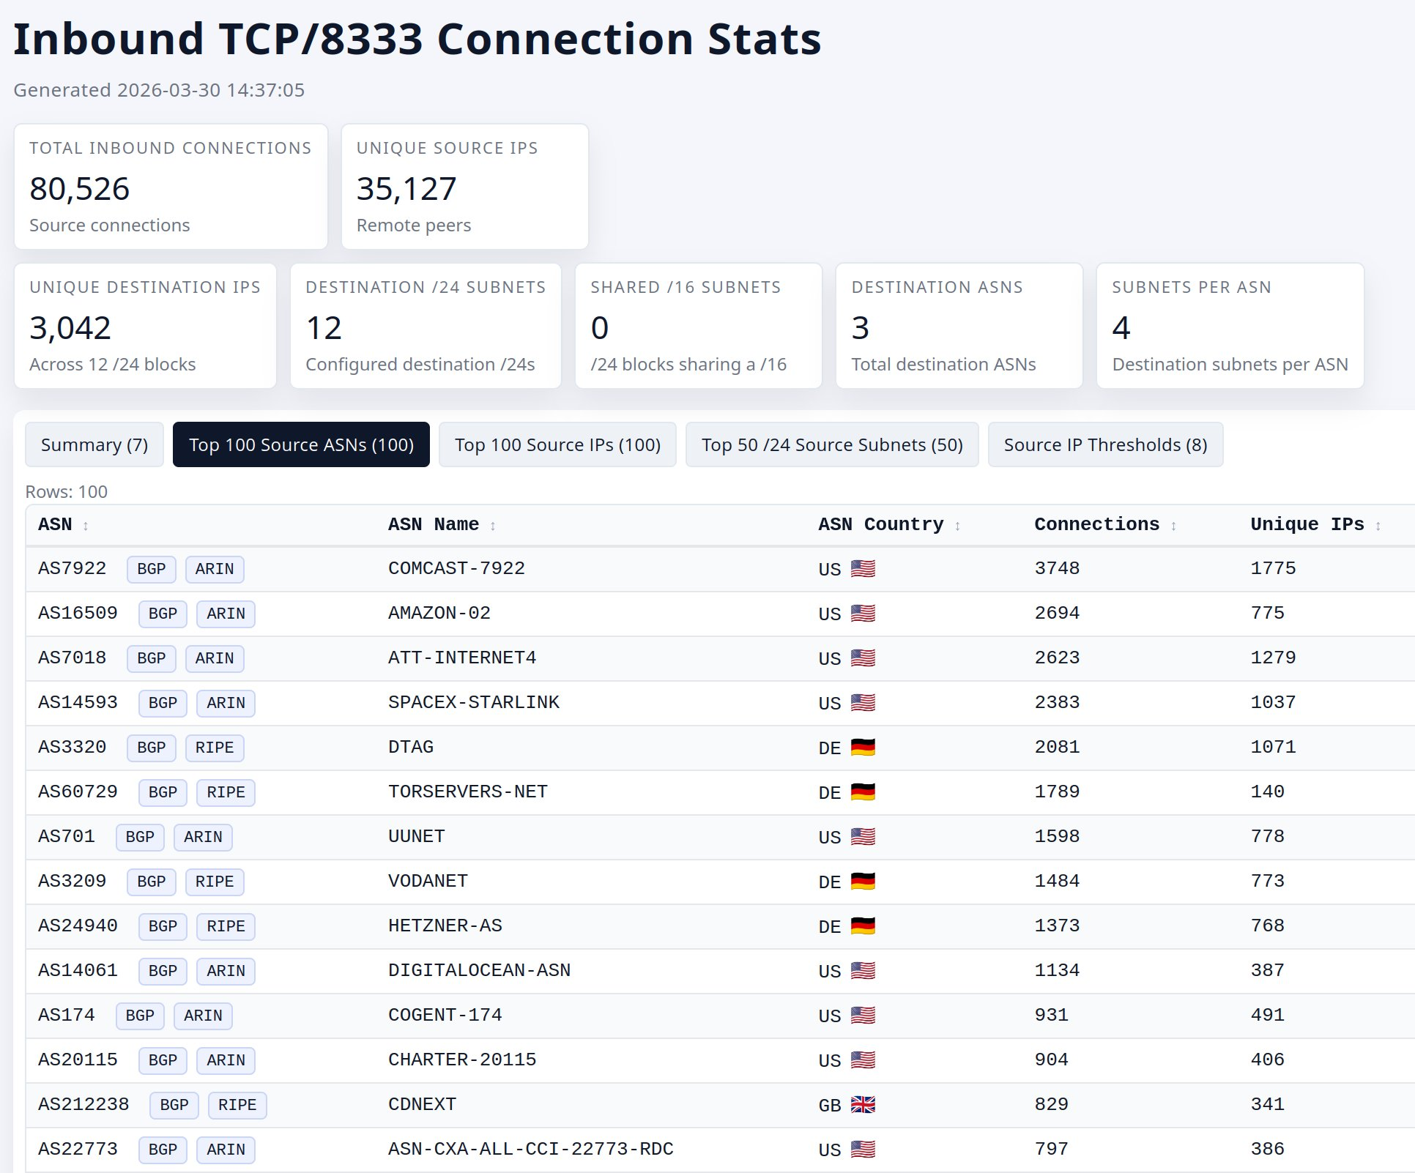
operators: 1

Slide 11
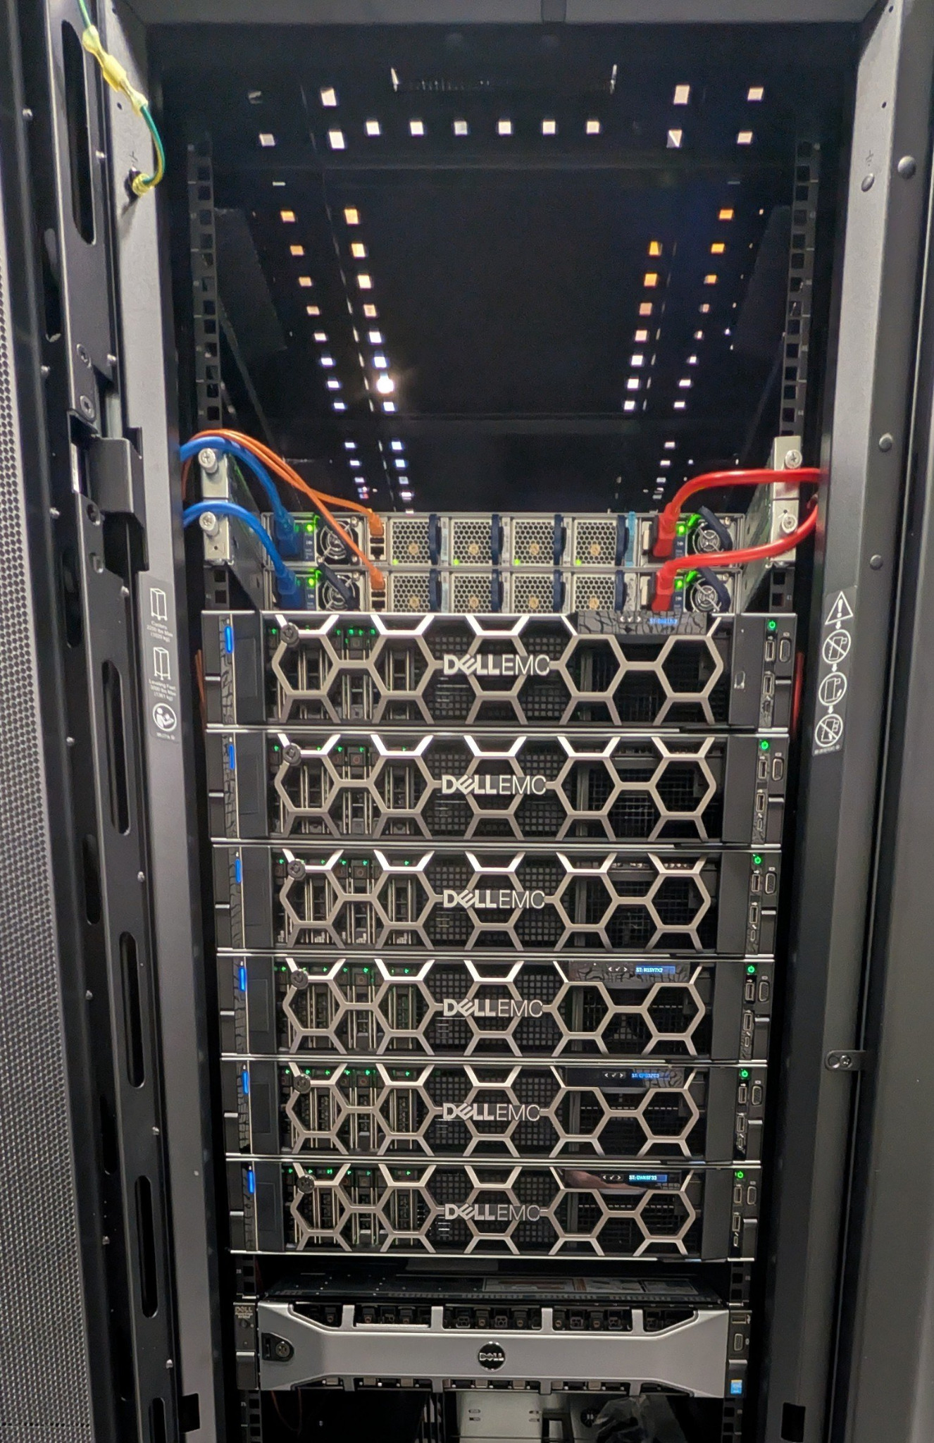
operators: 1

Slide 12
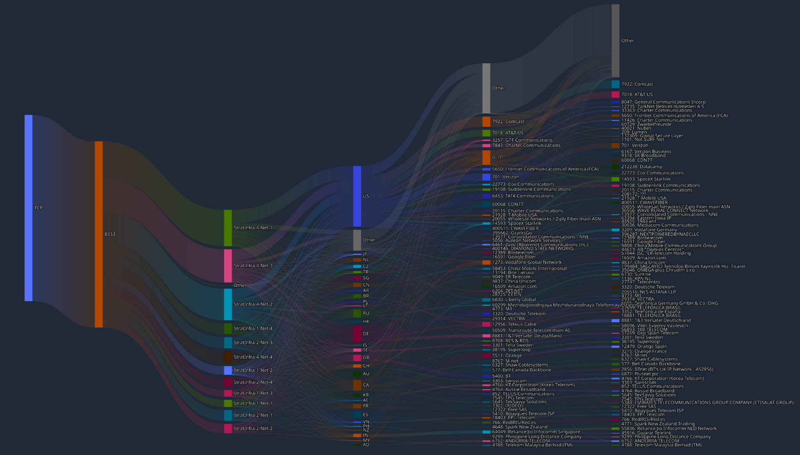
operators: 1

Slide 13
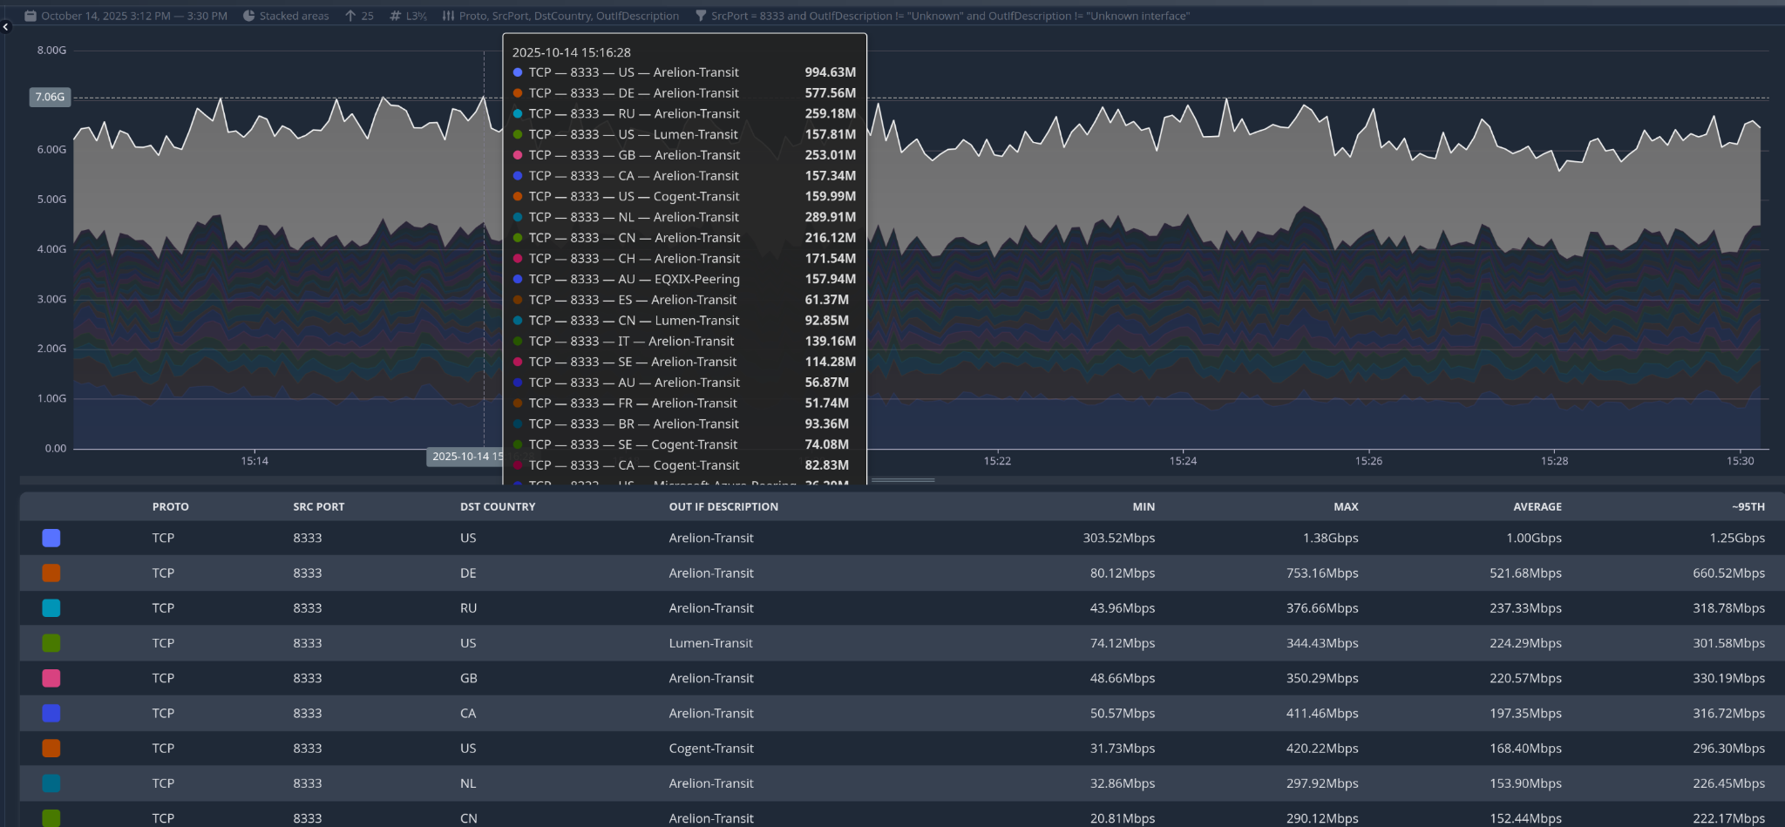
operators: 1

Slide 14
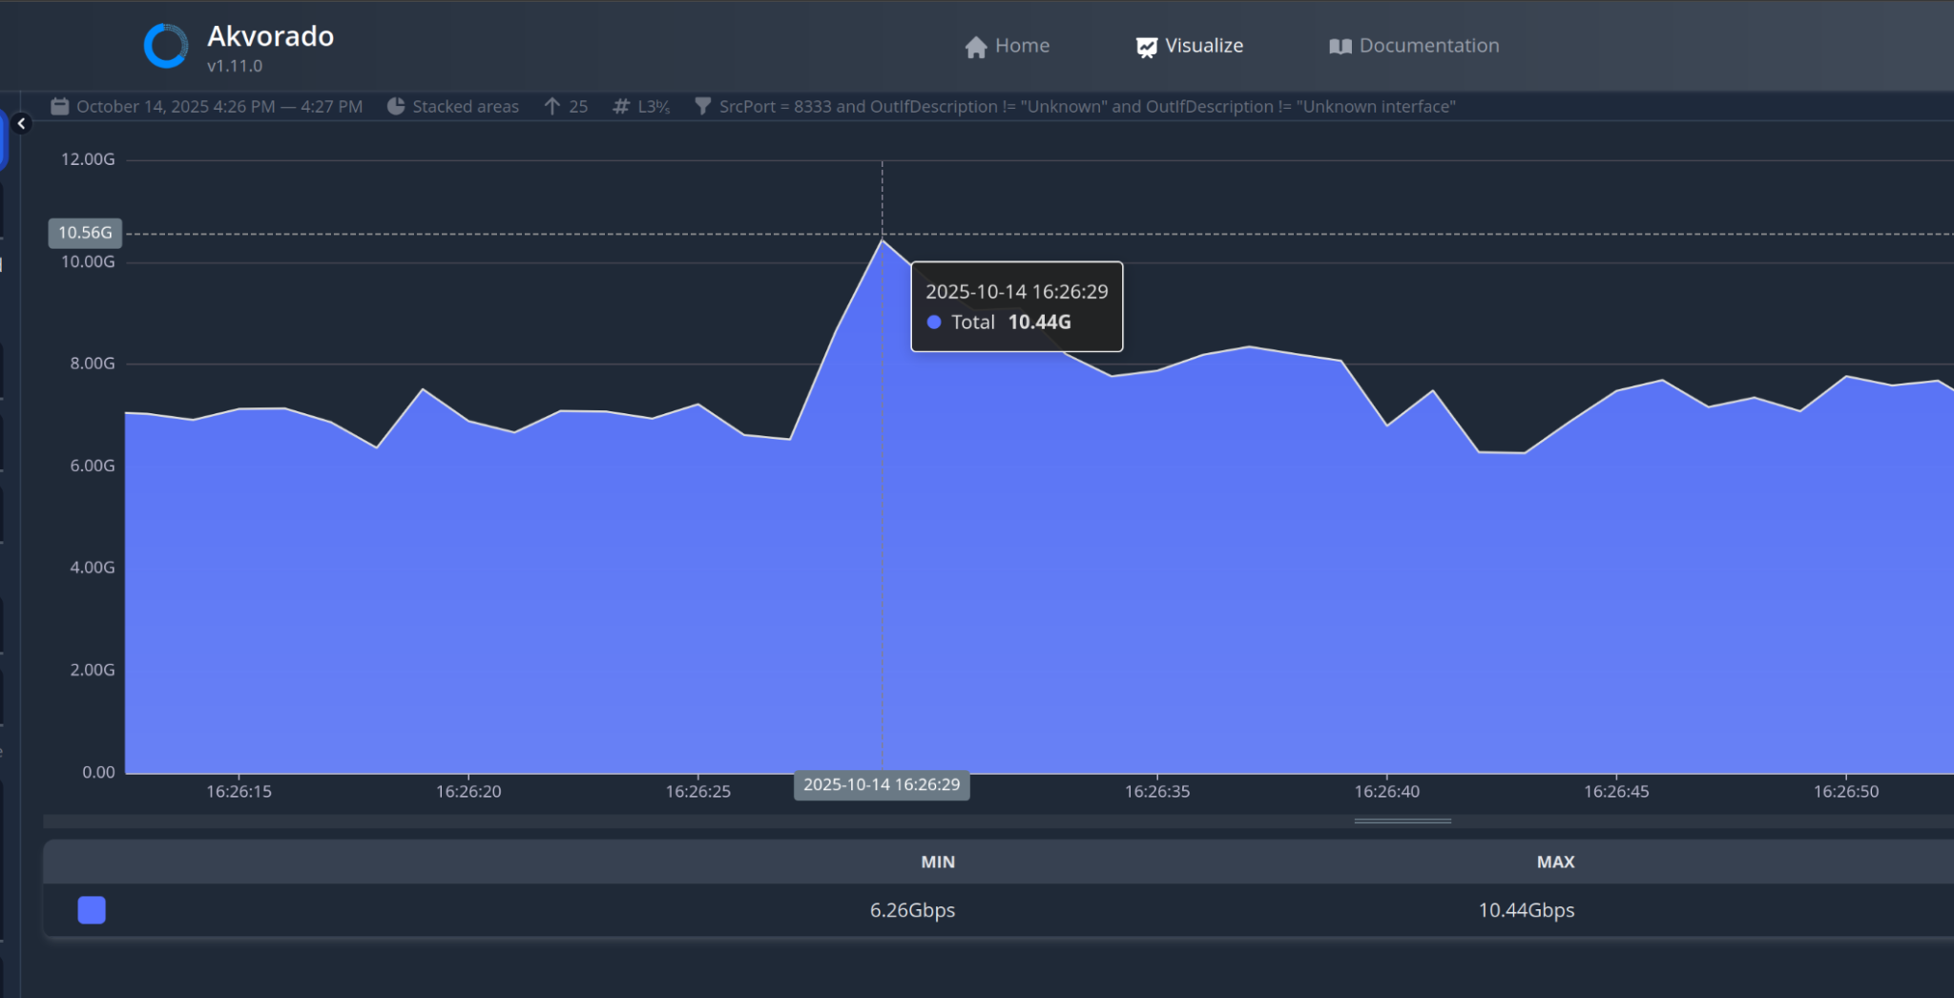
operators: 1

Slide 15
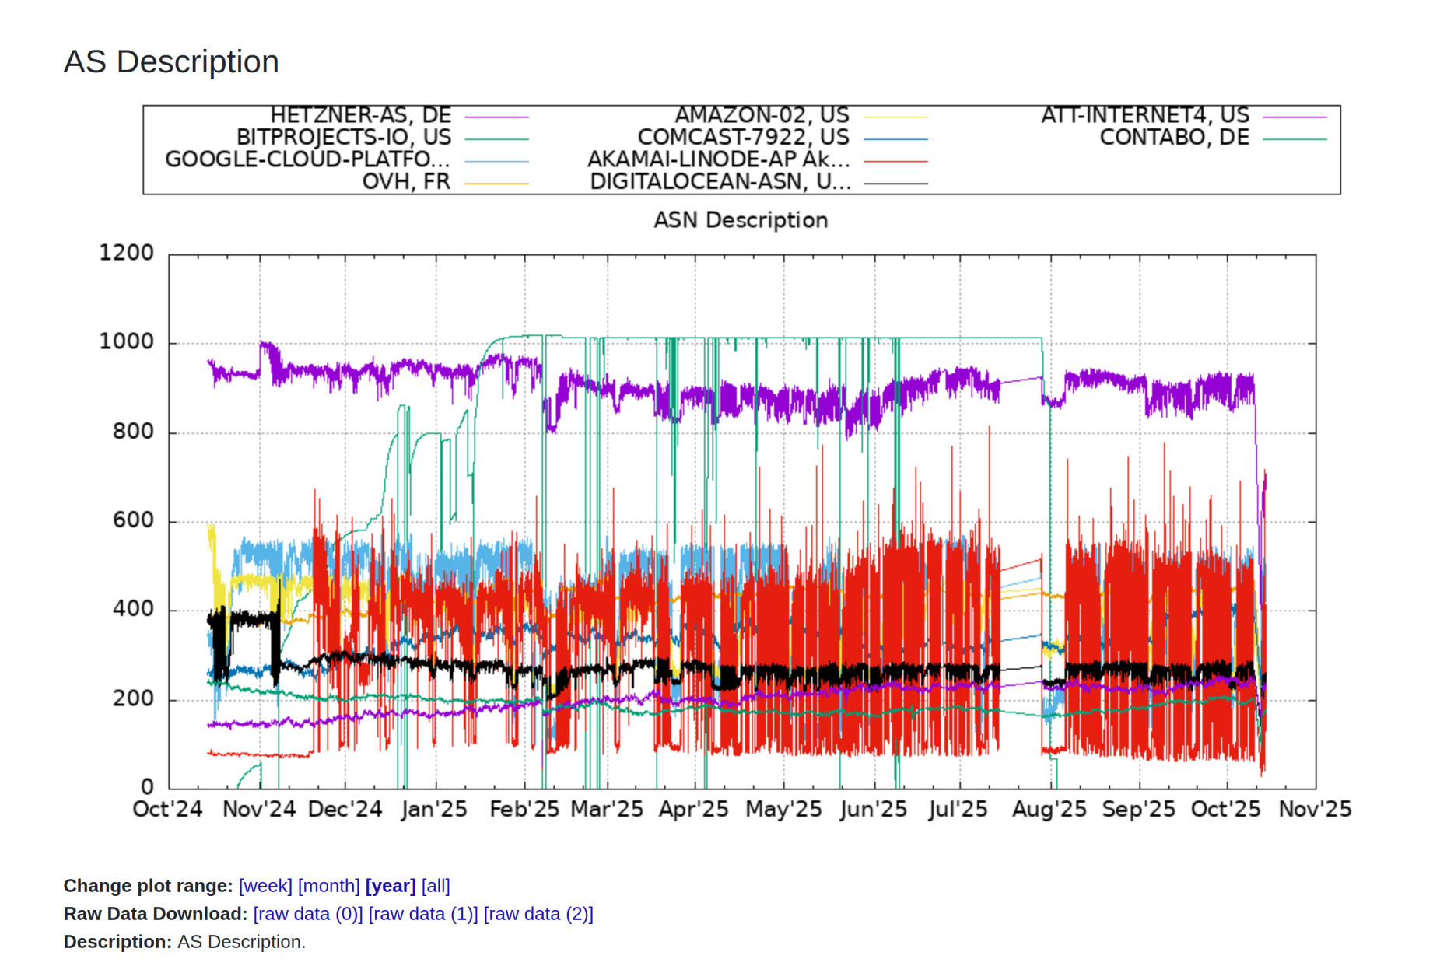
operators: 1

Slide 16
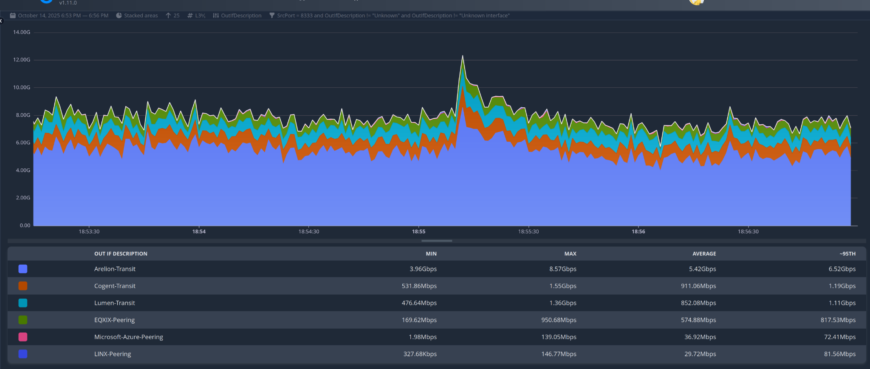
operators: 1

Slide 17
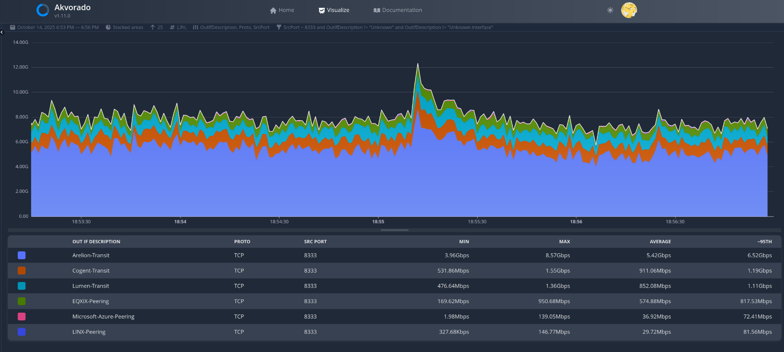
operators: 1

Slide 18
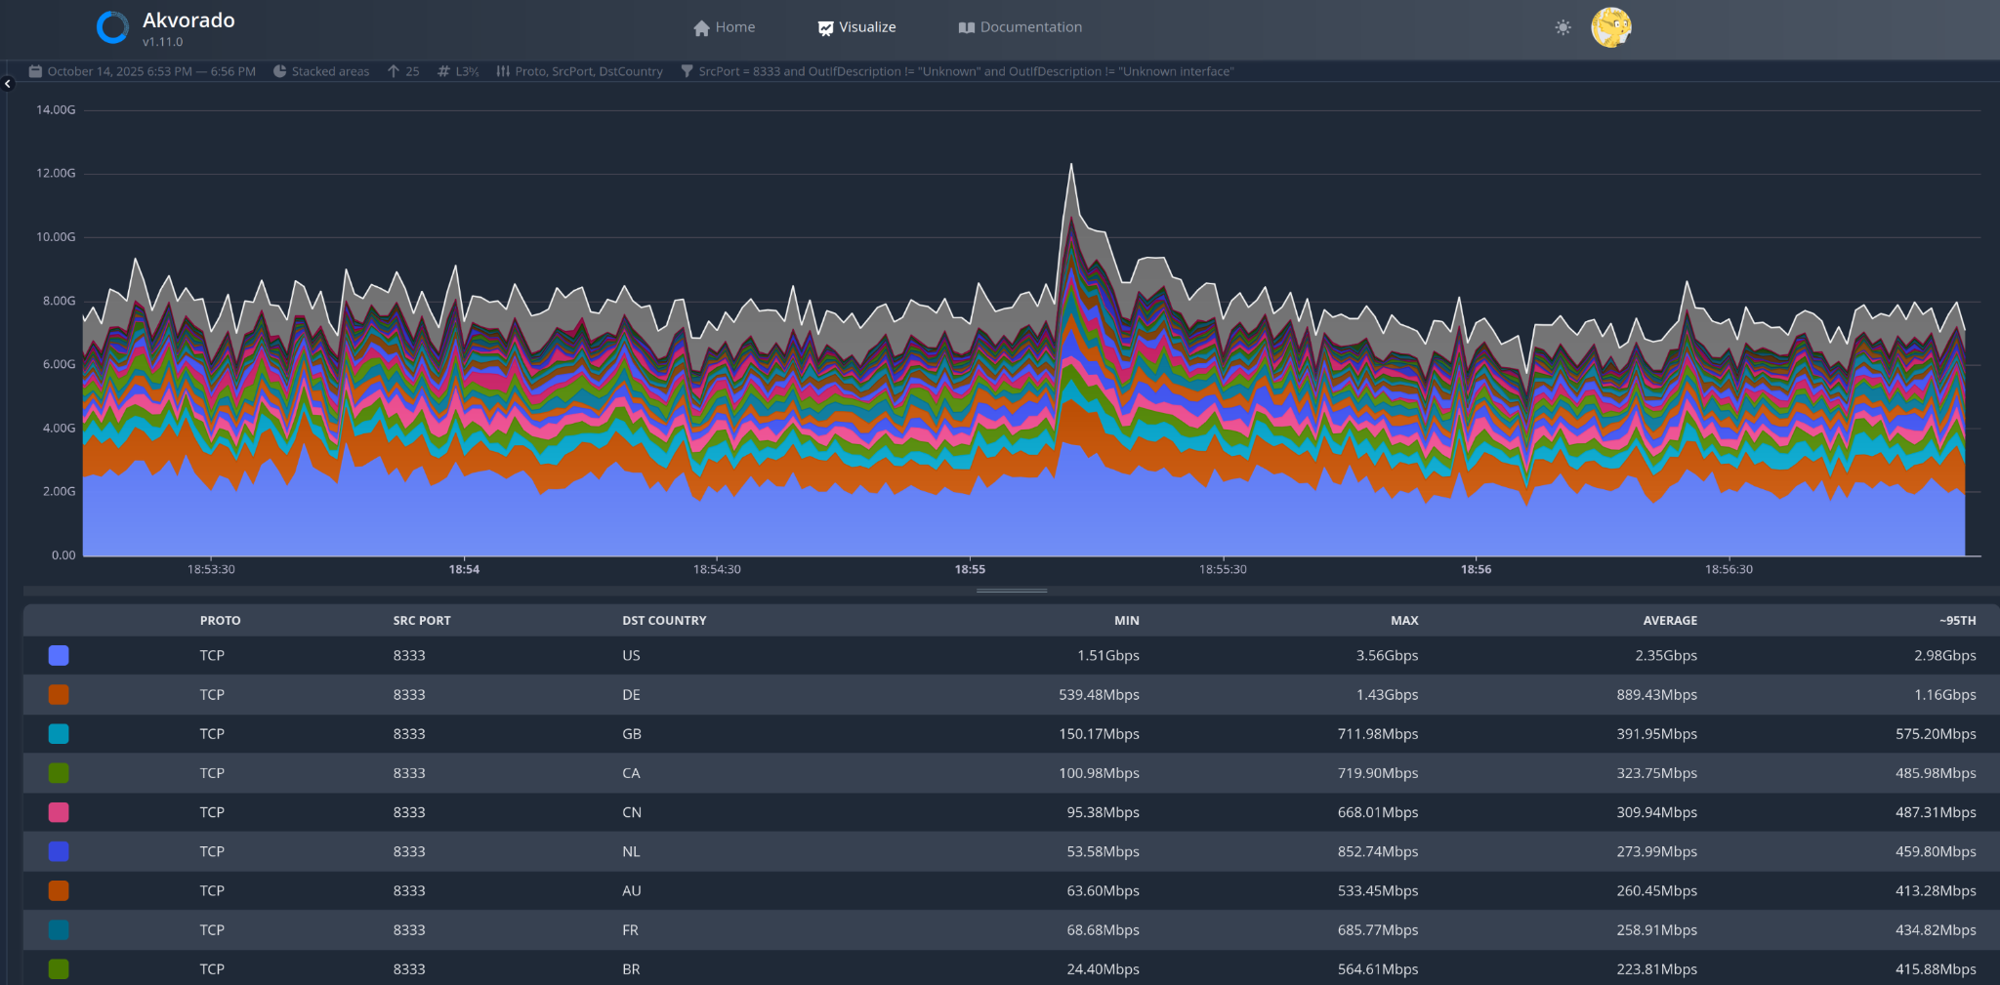
operators: 1

Slide 19
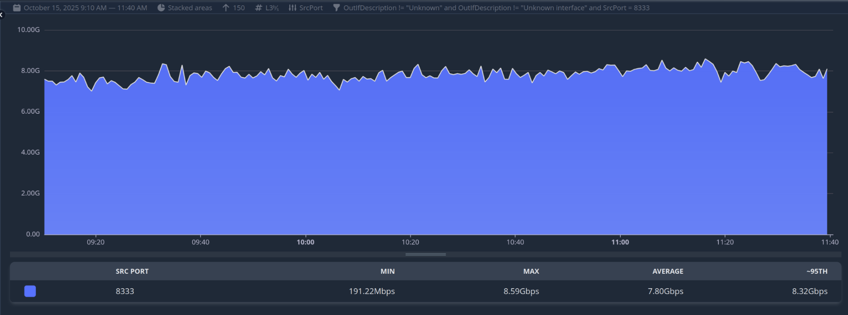
operators: 1

Slide 20
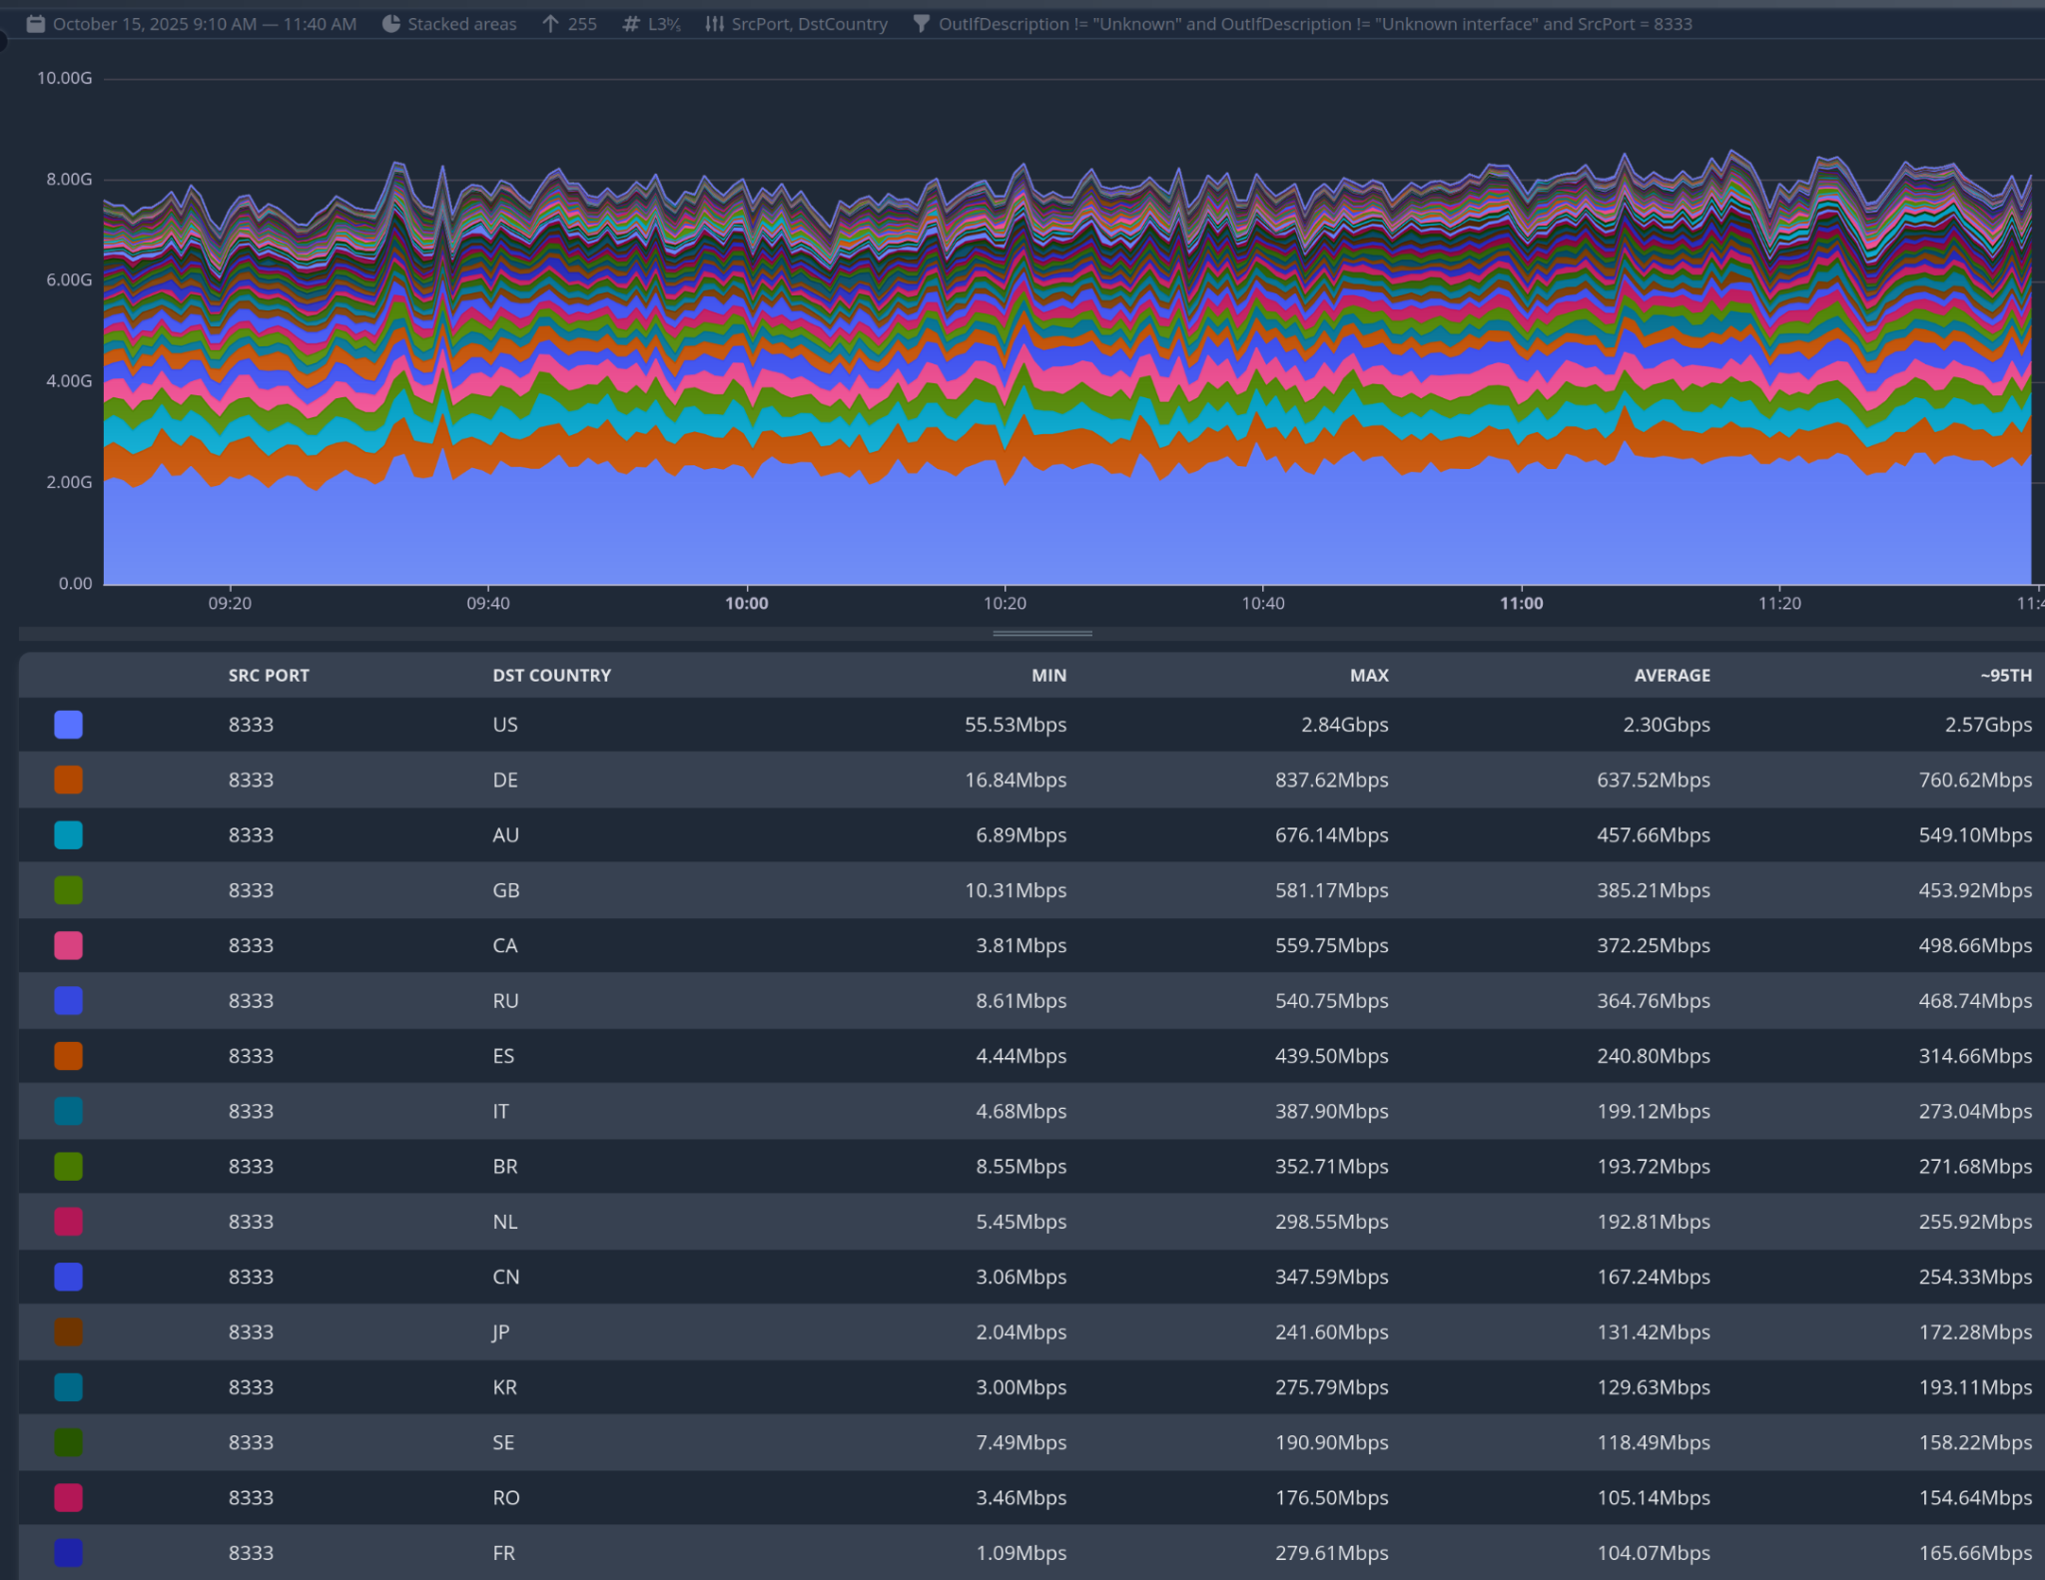
operators: 1

Slide 21
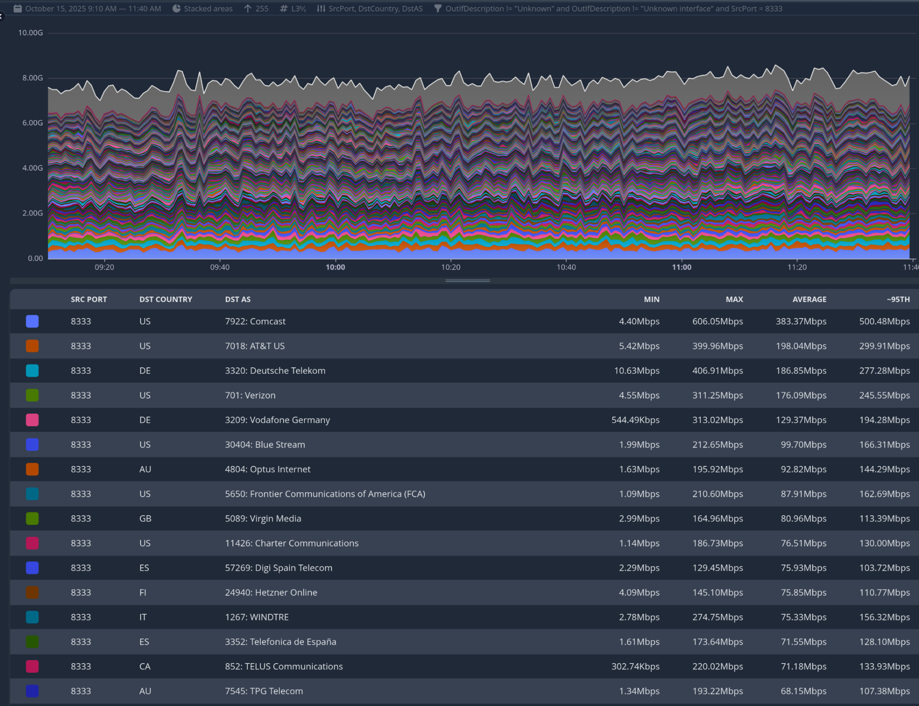
operators: 1

Slide 22
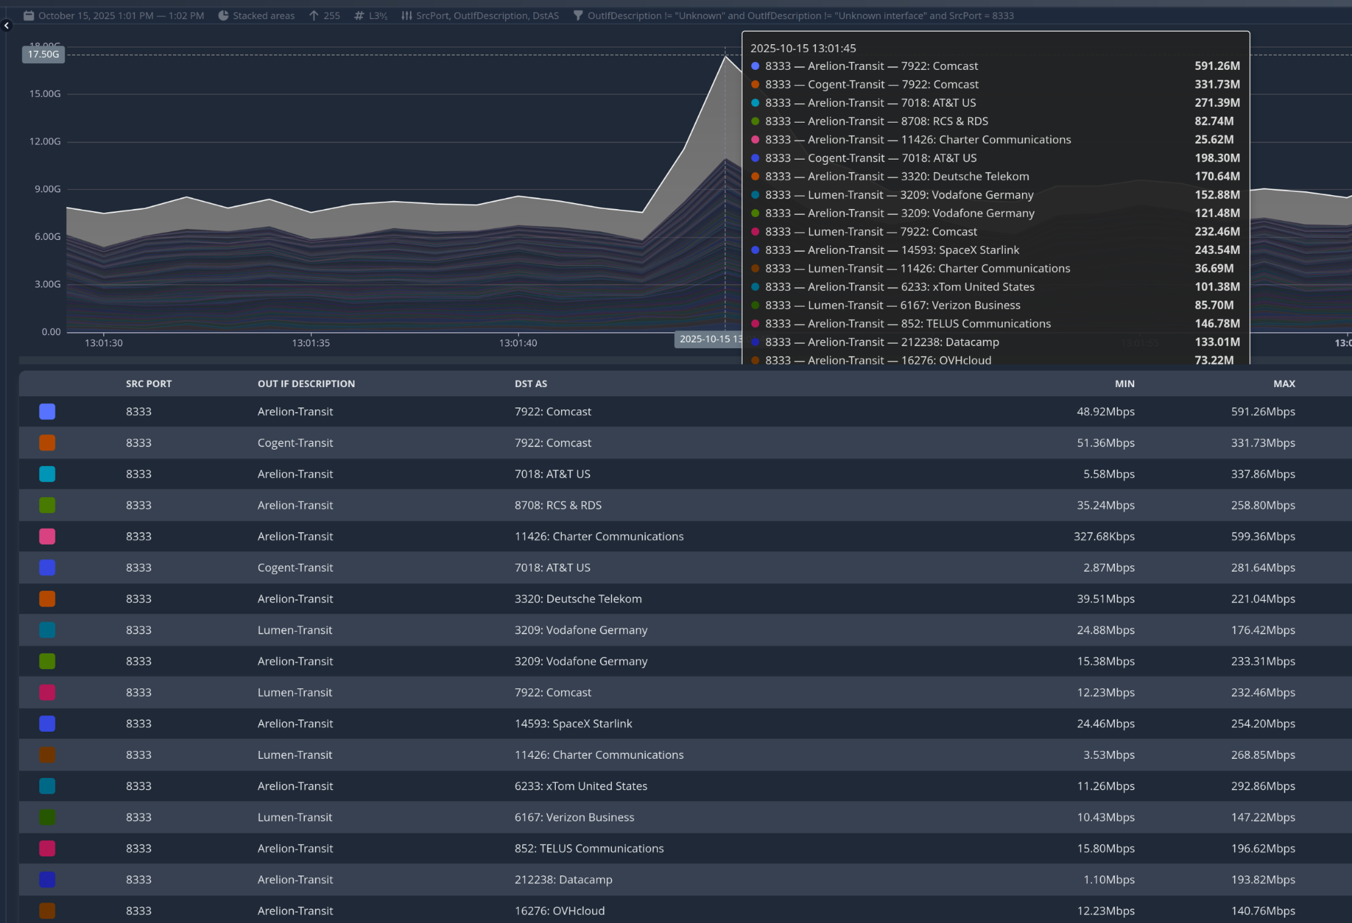
operators: 1

Slide 23
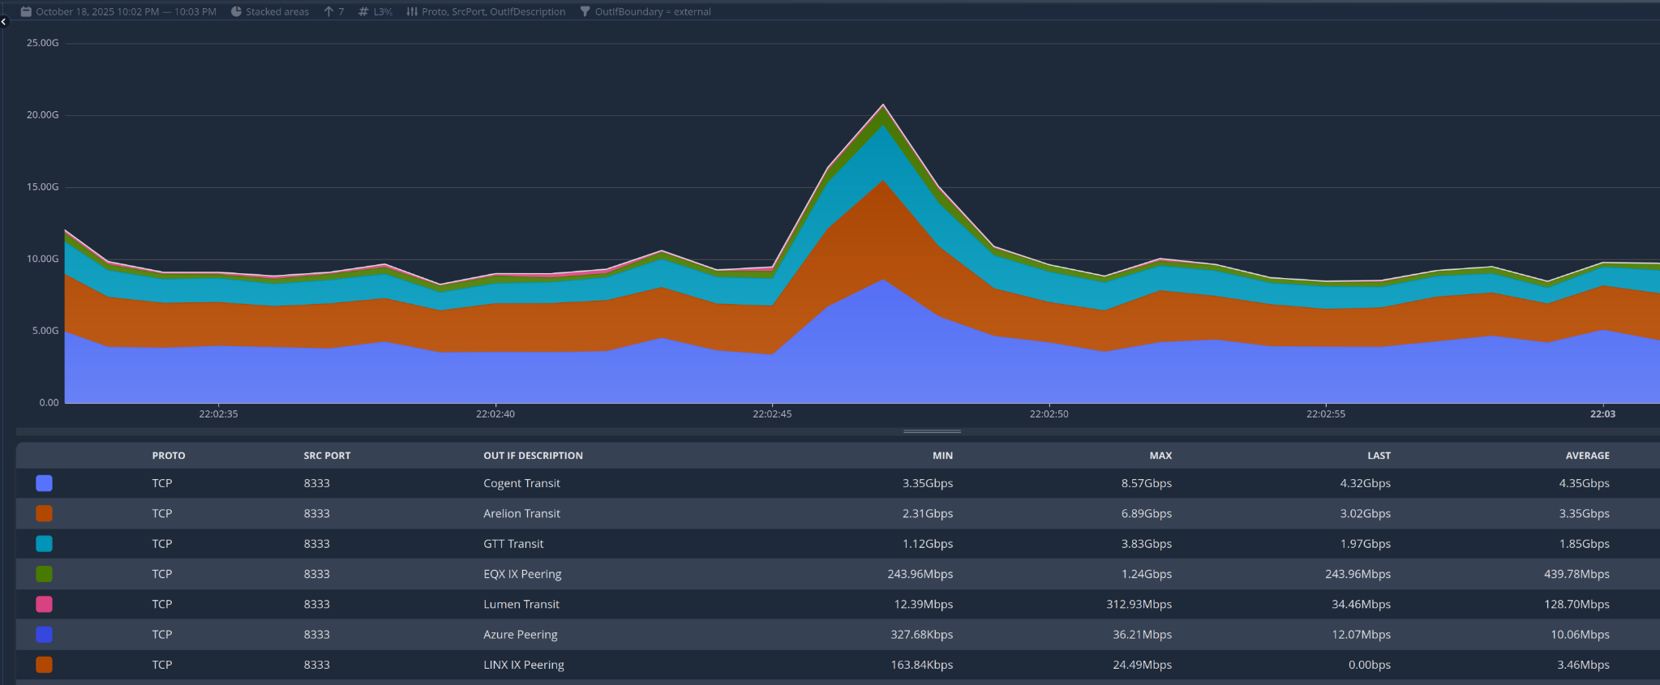
operators: 1

Slide 24
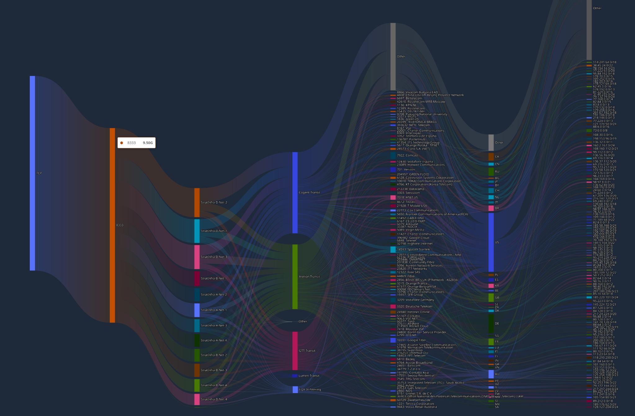
operators: 1

Slide 25
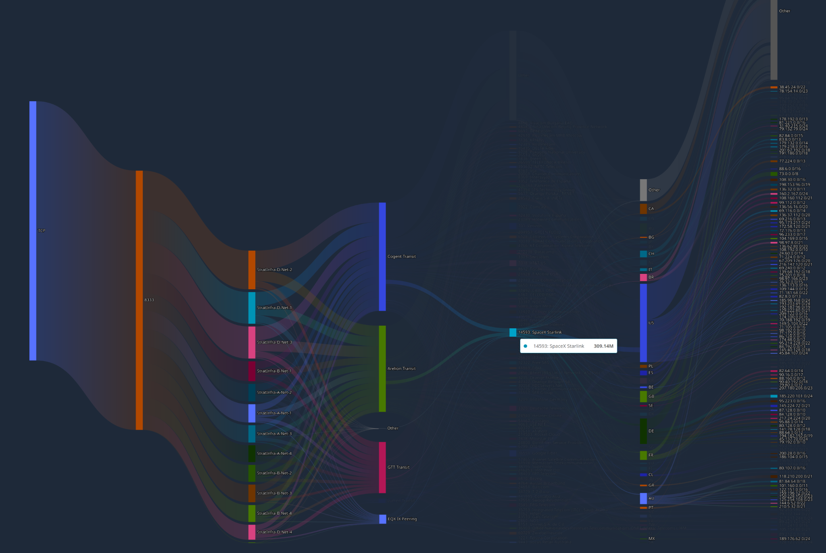
operators: 1

Slide 26
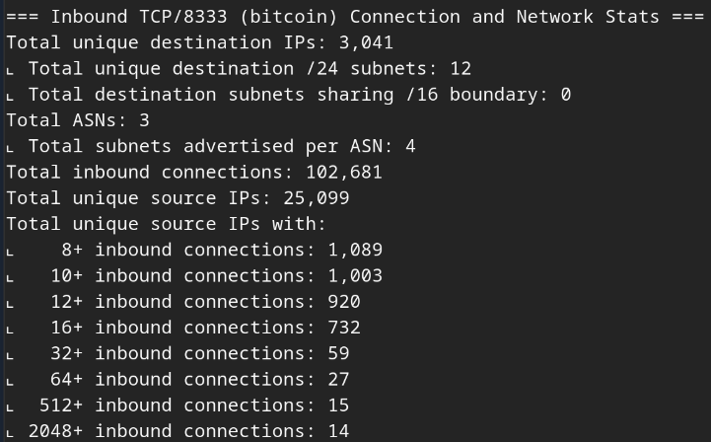
operators: 1

Slide 27
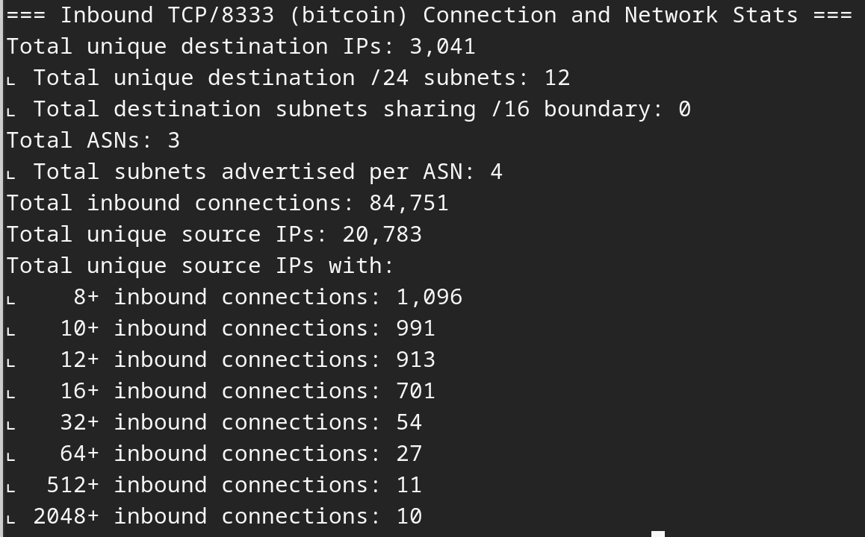
operators: 1

Slide 28
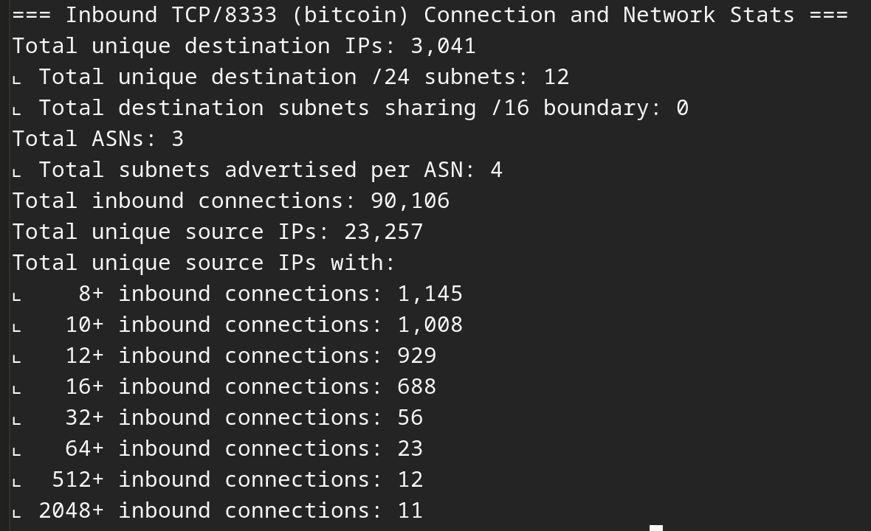
operators: 1

